Slide 1



Desafio de Projeto - Finacial
View in Power BI
Last data refresh:
27/12/2022 19:34:30 UTC
Downloaded at:
13/01/2023 03:56:39 UTC

Slide 2
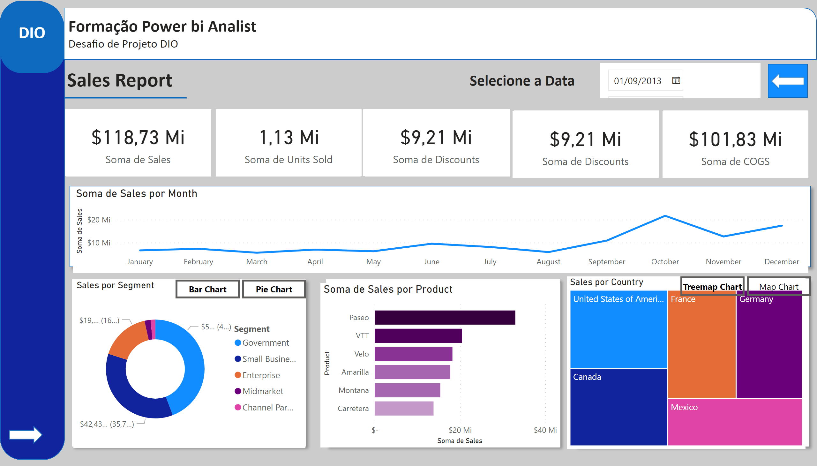
Página 1
Notes:
shape
No alt text provided
shape
No alt text provided
shape
No alt text provided
Sales por Country
No alt text provided
clusteredBarChart
No alt text provided
lineChart
No alt text provided
card
No alt text provided
card
No alt text provided
card
No alt text provided
textbox
No alt text provided
shape
No alt text provided
shape
No alt text provided
shape
No alt text provided
shape
No alt text provided
shape
No alt text provided
shape
No alt text provided
textbox
No alt text provided
shape
No alt text provided
shape
No alt text provided
shape
No alt text provided
shape
No alt text provided
shape
No alt text provided
shape
No alt text provided
textbox
No alt text provided
shape
No alt text provided
shape
No alt text provided
Bar Chart
No alt text provided
Sales por Segment
No alt text provided
Pie Chart
No alt text provided
Map Chart
No alt text provided
TreeMap Chart
No alt text provided
Sales por Country
No alt text provided
slicer
No alt text provided
actionButton
No alt text provided
textbox
No alt text provided
card
No alt text provided
card
No alt text provided
clusteredBarChart
No alt text provided

Slide 3
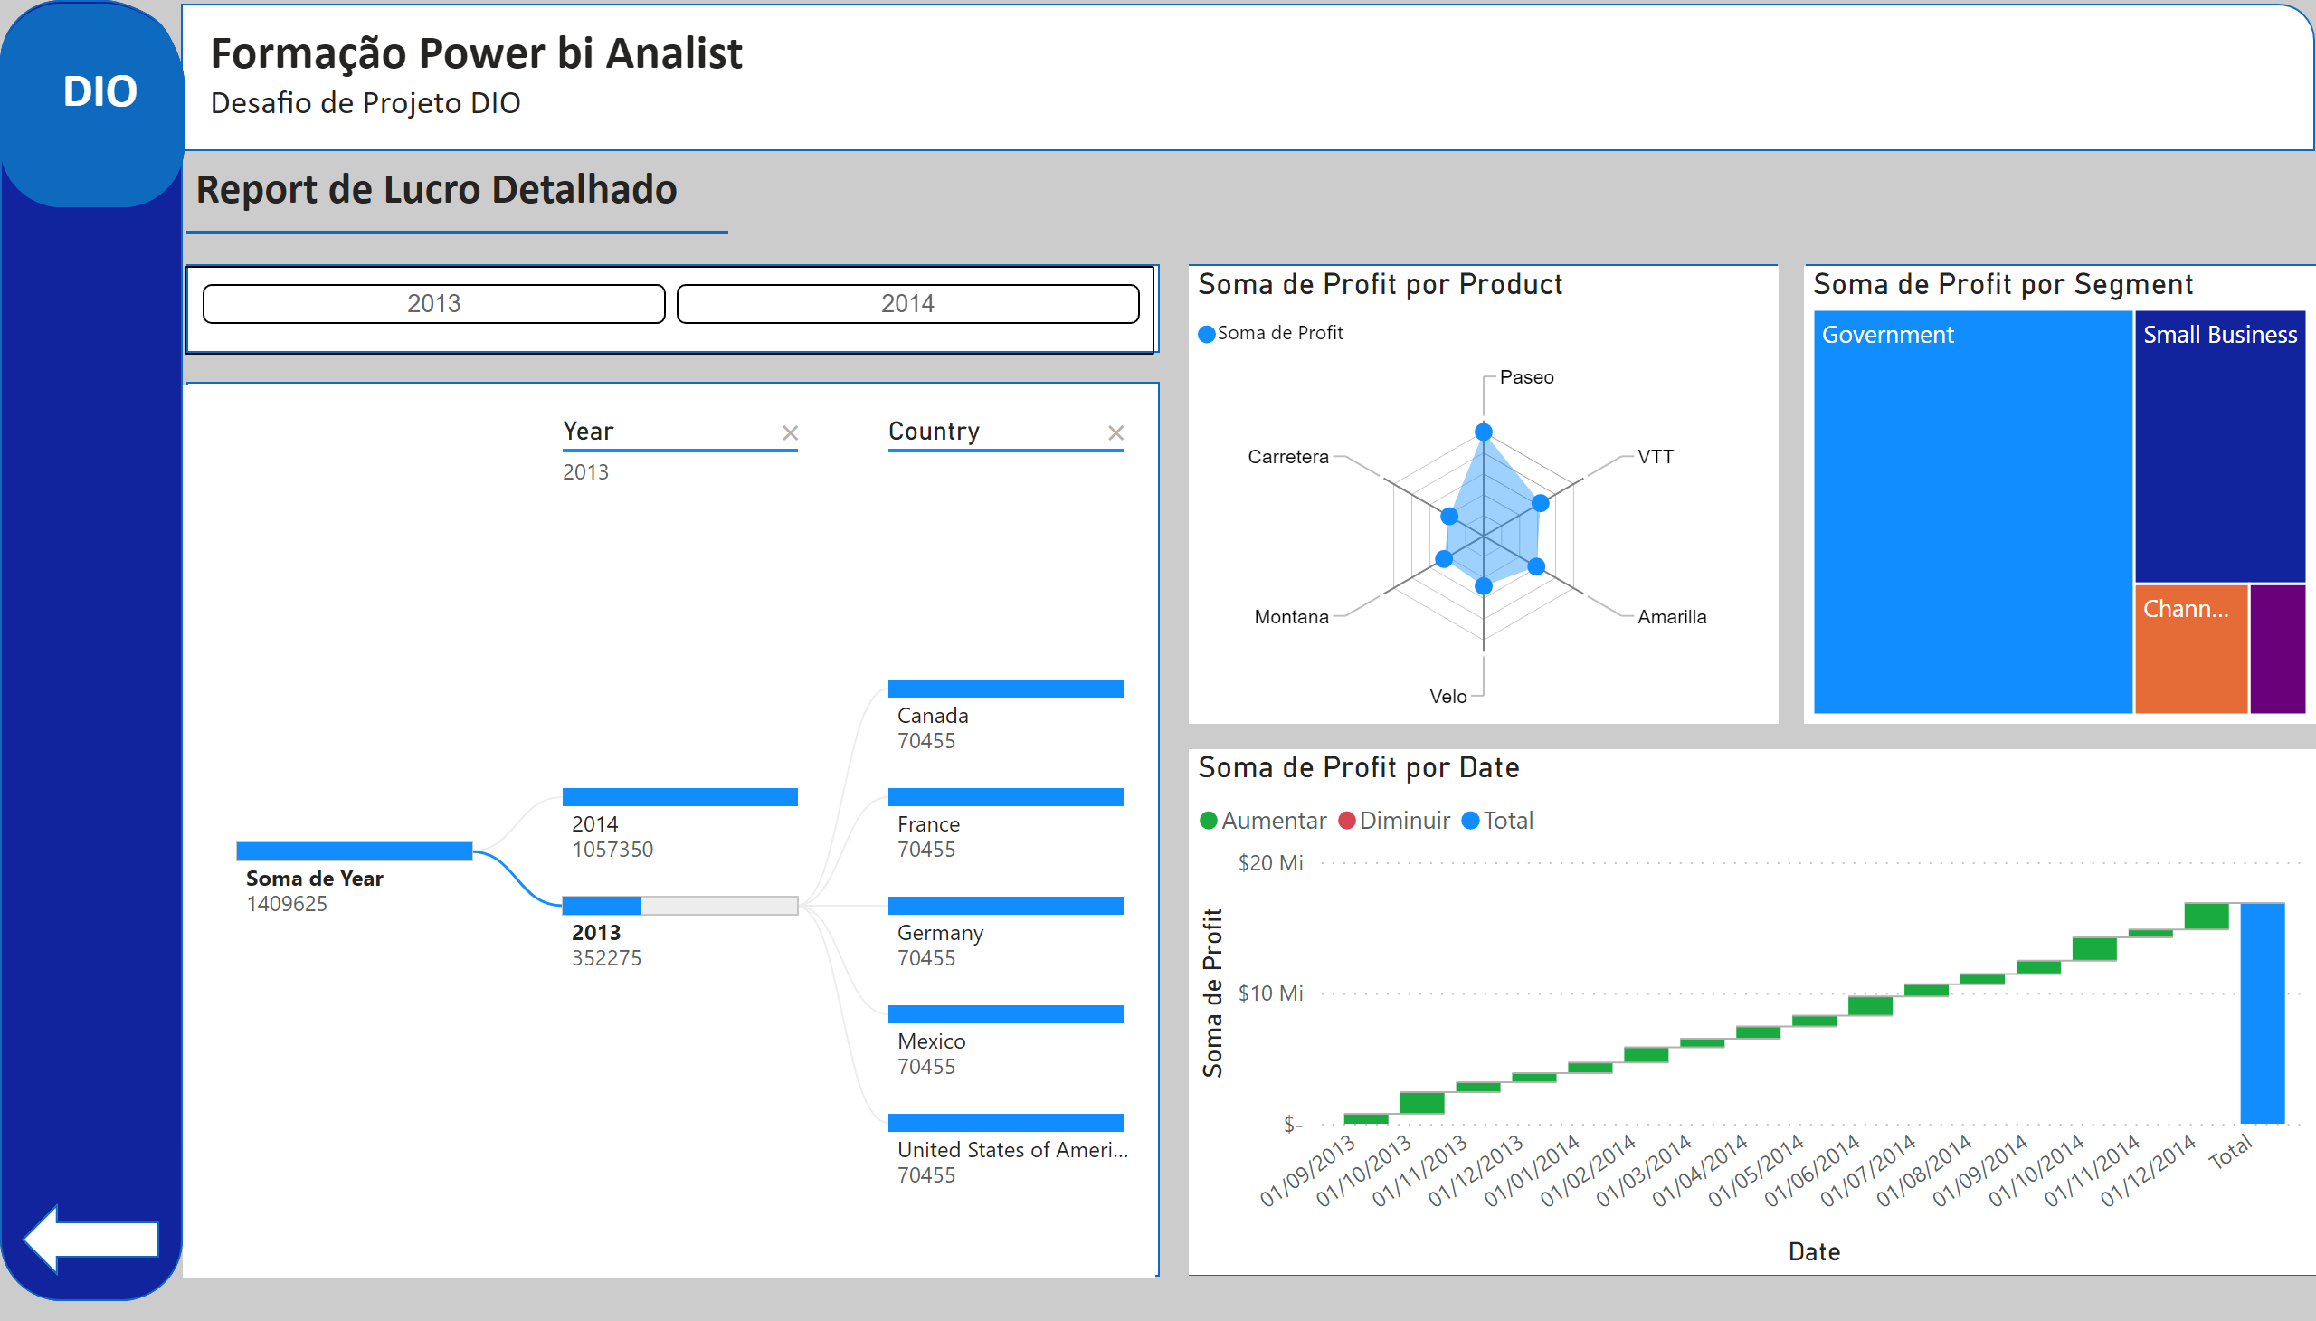
Página 2
Notes:
decompositionTreeVisual
No alt text provided
waterfallChart
No alt text provided
treemap
No alt text provided
RadarChart1446119667547
No alt text provided
ChicletSlicer1448559807354
No alt text provided
shape
No alt text provided
shape
No alt text provided
shape
No alt text provided
shape
No alt text provided
shape
No alt text provided
textbox
No alt text provided
shape
No alt text provided
textbox
No alt text provided
shape
No alt text provided
textbox
No alt text provided
shape
No alt text provided
shape
No alt text provided
shape
No alt text provided
textbox
No alt text provided
shape
No alt text provided

